Slide 1
Engineers Without Borders GWU-CE6800 Collab
Bhutiya Water Management Program
Sophia Ertel, Olivia Cantrell, Tom Arena, Grace Olenzak

Slide 2
Introduction
01
Objective & Background
02
TABLE OF CONTENTS
Technical Approach
03
04
Phase I
05
Phase II
06
Phase III
Notes:
01 Sophia
02 Sophia
03 Grace
04 Olivia
05 Sophia
06 Tom & Grace

Slide 3
01
Introduction

Slide 4




Meet the Team
Sophia Ertel
Olivia Cantrell
Tom Arena
Grace Olenzak
Notes:
Insert yo headshots

Slide 5
02
Objective & Background

Slide 6
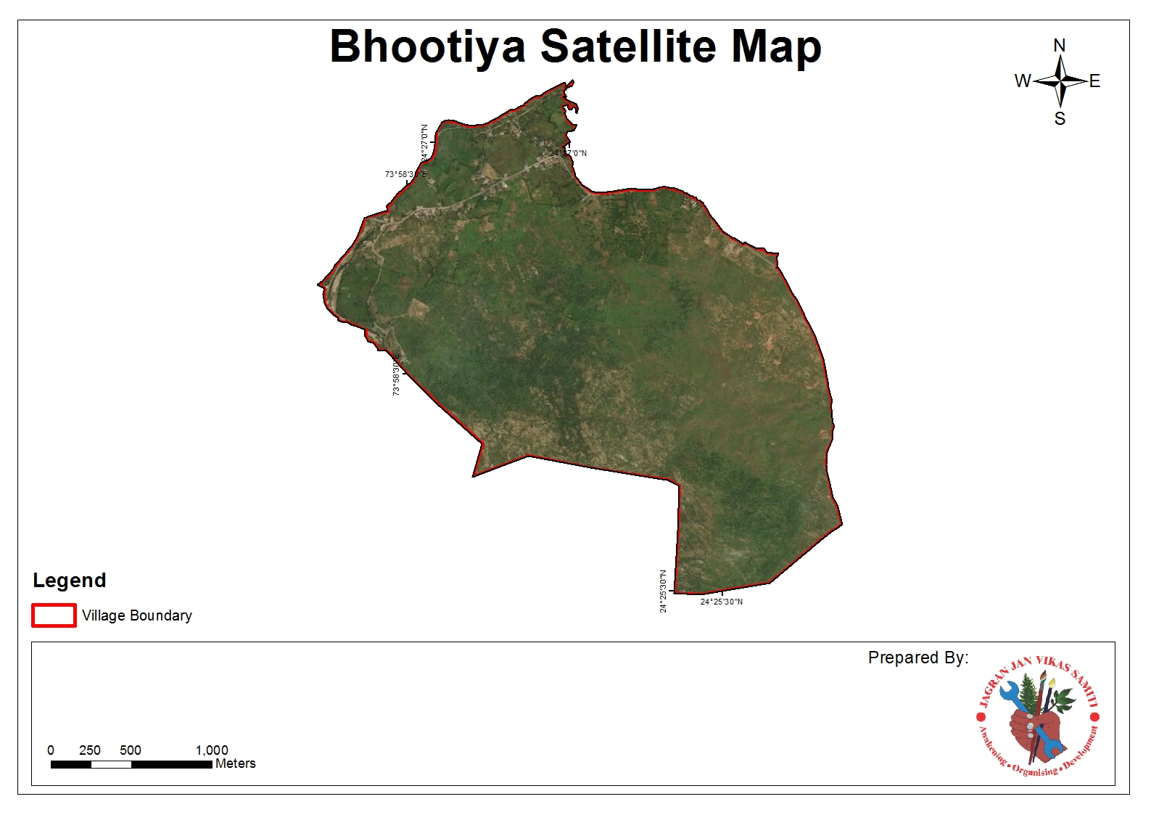
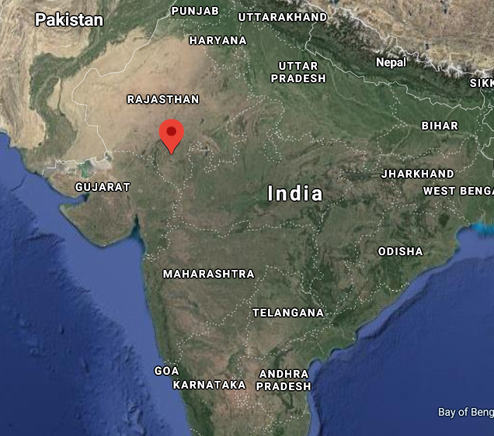
The Bhutiya Water Management Project
Population: 408 (100 households)
Area: 495 hectares
Industry: Agriculture & Livestock
Project Est.: 2017
Notes:
desert region of Rajasthan, India
nine month dry season (Community-wide monsoon rainwater dependency)
report elevated water scarcity
overuse of groundwater
poor water conservation
failure and malnutrition of livestock and family members
70% of the southern Rajasthan population in the agriculture industry, water scarcity has a vast impact on livelihood, health, and economic stability.

Slide 7




Project Partners
Notes:
2 seconds

Slide 8
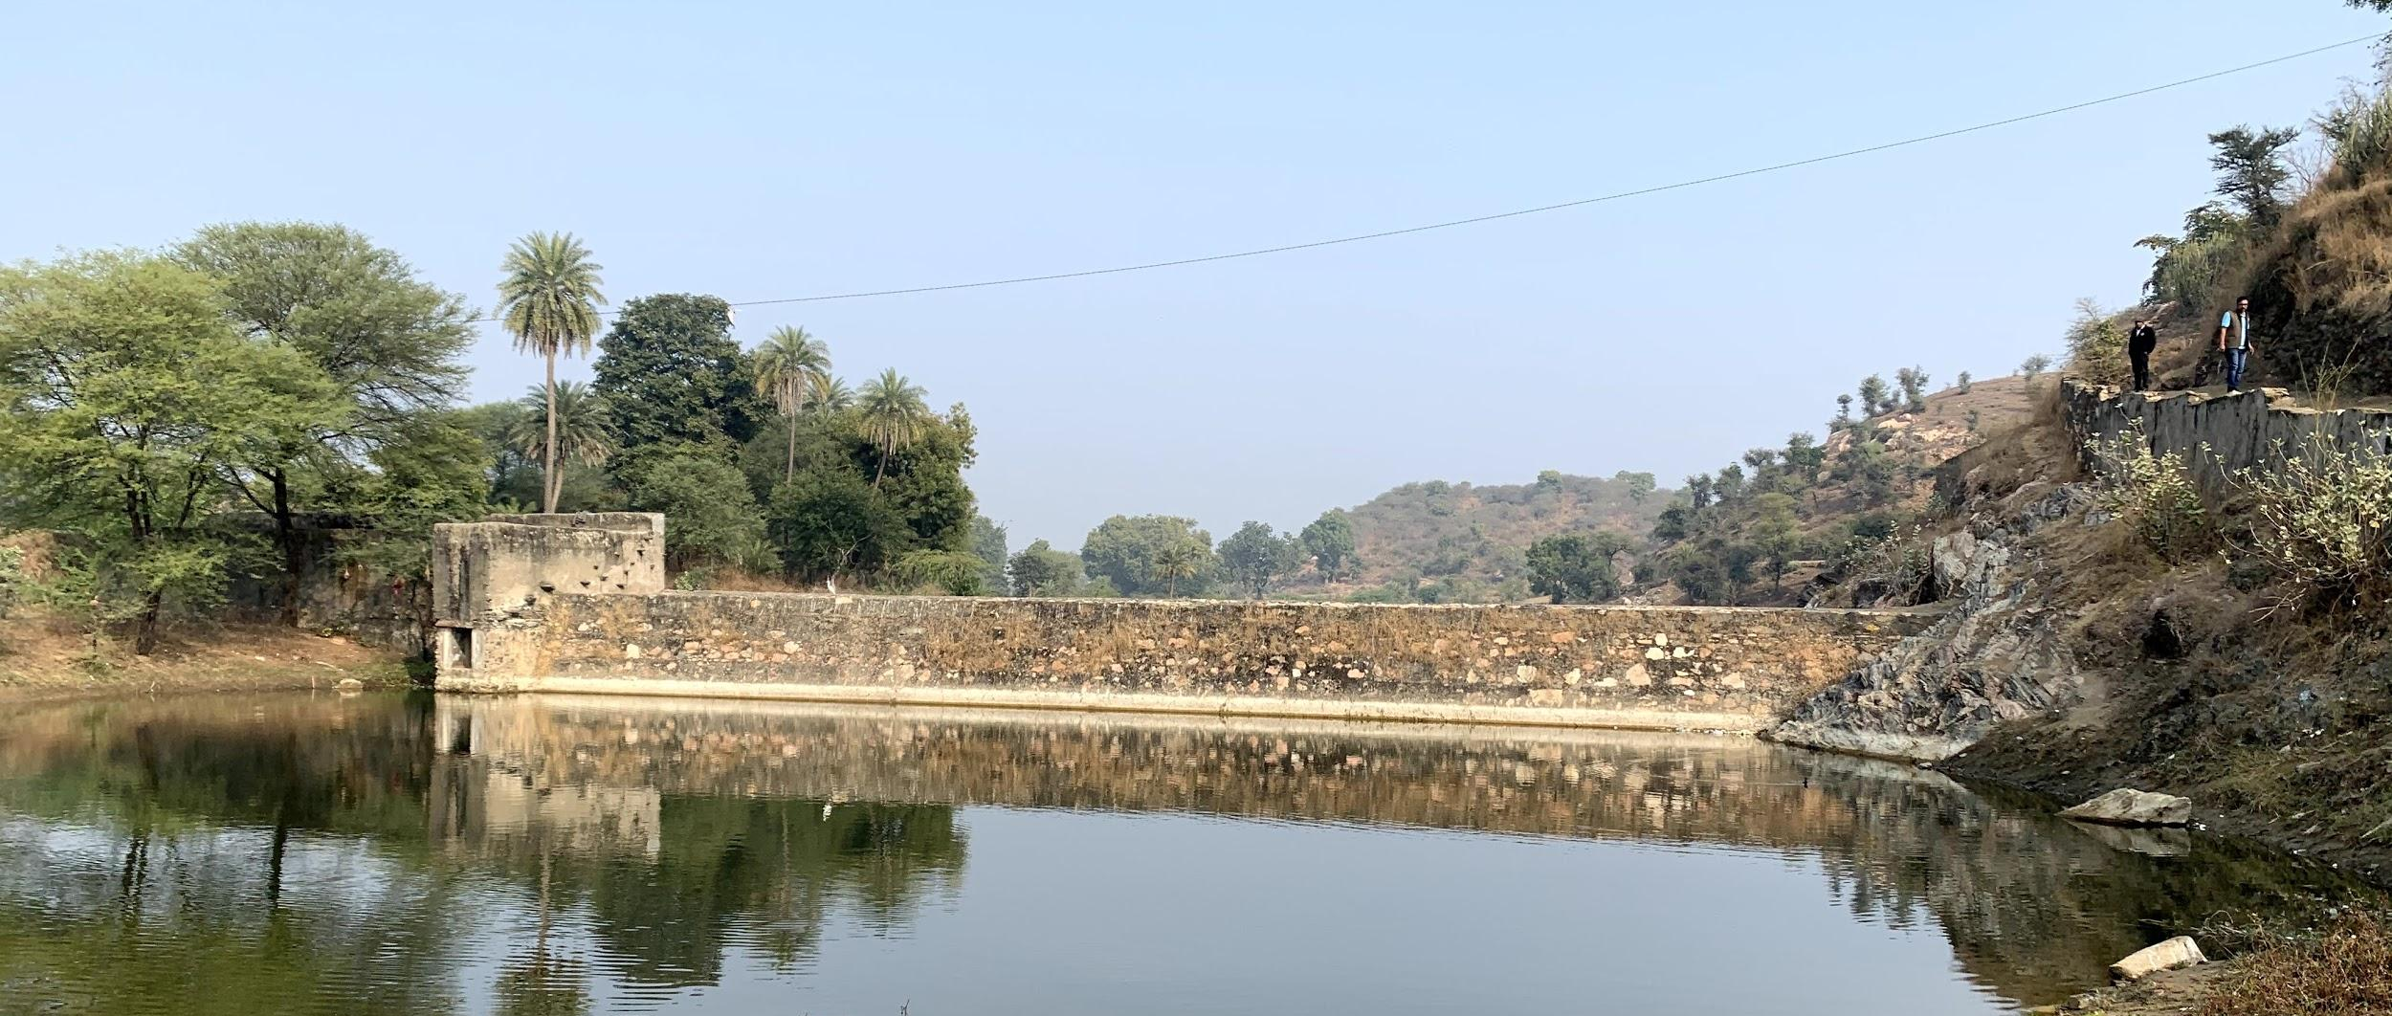
PROGRAM OBJECTIVES
DESIGNED SOLUTION
Anicut / Dam
Percolation Pond
Contour Trenching
Introduce resilient water infrastructure
Reduce groundwater dependence
Increase supply
Improve efficiency
Notes:
EWB objectives

Slide 9
Objective
Use a variation of functions and models to predict future precipitation near Udaipur, India and subsequent runoff data for the purpose of implementing a safe, efficient, and sustainable design for an anicut dam and percolation pond for increased access to water resources in the community of Bhutiya.
Notes:
How our data science team supports the mission of EWB

Slide 10
03
Technical Approach
Notes:
Moving on, we are going to give you a brief

Slide 11
Three-Part Approach
PHASE I
PHASE II
PHASE III
Predicting Precipitation
Hydraulic Modeling
Sizing Reservoir and Dam
Historical Rainfall
Climate Change
50 yr Precipitation
Catchment Area
Volume of Runoff
Google Earth Terrain
50 yr Precipitation
Volume of
Runoff/ yr
Dam & Pond Dimensions
Notes:
We decided to split our project into 3 phases: phase one focused on predicting the annual precipitation data for the upcoming 50 years using historical rainfall data as well as climate data for the area. we chose 50 years so that the dam can have a minimum useful life of a half century.
Phase II focused on finding the catchment yield of the reservoir. The predicted rainfall from phase I was used to essentially find how much water the pond and dam should be designed to hold.
Phase III used this annual expected volume to find the maximum amount of water to design for. This volume along with the Natural Terrain data was used from google earth to make assumptions for a valid sizing of the dam and the pond.
Olivia phase 1
….
And it will be presented respectivley

Slide 12
PROGRAMS & PACKAGES
PROGRAMS USED
PYTHON PACKAGES
Python
Jupyter Notebook
Google Earth Pro
Pandas Numpy
Matplotlib Seaborn
Os Plotly
Math Plotly.graph_objects
Ipywidgets Units
Notes:
For the completion of this project, we mostly used python- Jupyter notebook to analyze our data and created a full repository in github. In addition, we used google earth pro to get familiar with the natural layout of the land where the dam is expected to be placed.
The python packages that we used are also listed on this slide. Some of them are very common, and some of them we had fun with playing around and getting familiar with them.

Slide 13
04
Phase I
Data Visualization &
Precipitation Prediction

Slide 14
Data Collection - Literature Review
Climate Models
Precipitation Models
Potential Data Sources
Independent variables
Climate change (more extreme weather)
Similar models in Python
Regression
Time series
Indian Meteorological Department
FAO
World Water and Climate Atlas
Notes:
Literature review to learn more about precipitation and climate change models
Looking to see what independent variables are commonly used to predict precipitation
Information that climate models often disagree with each other as this is an emerging science, combing many fields of math, science, and engineering
Important since with greater temperature we are experiencing due to climate change, it is predicted that wet areas will become more wet and dry areas will become more dry
Precipitation models - information about methods used for python precipitation prediction models. Have basic knowledge of time series from the course
Potential sources of data - research precipitation predictions in India to learn how the government and organizations organize their data
Food and agriculture organzation
variables
Temperature
Atmospheric moisture content
Winds
Air pressure
Plant evapotranspiration
Atmospheric circulation
Soil moisture

Slide 15
Data Collection
Independent Variables
Difficult to collect weather data
Assumptions
Precipitation data for East Rajasthan
Temperature for India
Current model predicts precipitation with only temperature
Precipitation impacted by topography
Temperature
Atm. Moisture Content
Winds
Air Pressure
Evapotranspiration
Atm. Circulation
Soil Moisture
Notes:
Difficult to collect weather data
As a developing nation, the limited availability and accessibility of such information hinders potential research
Data is hard to get bc:
There is little coordination between various data collecting agencies
Similar data collected by more than one organization so can lead to confusing results
Low emphasis on the use of electronic media for sharing the collected data
On the right is a list of the independent variables that are frequently used to predict precipitaton
Temperature is useful since there is a strong relationship between temperature and evapotranspiration, relating the energy and hydrological cycle

Slide 16
Data Visualization

Slide 17
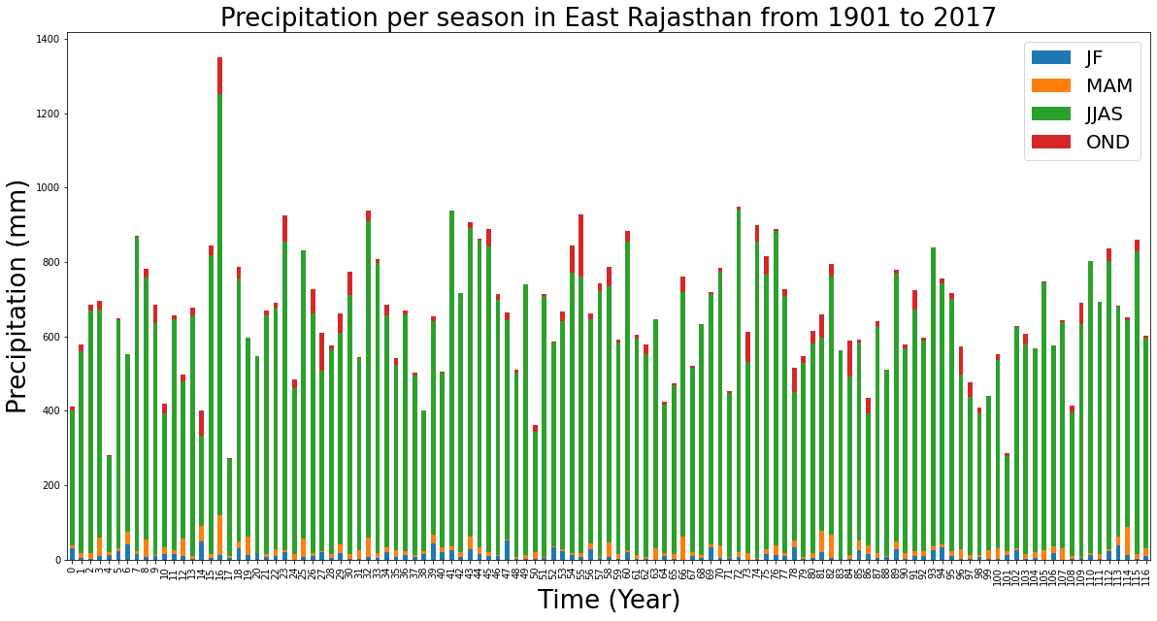
Notes:
Stacked bar chart, illustrates the proportion that each season contributes to the annual precipitation
Green is JJAS (june july august september) which is monsoon season in India
The orange and blue are very small compared to the green bars

Slide 18
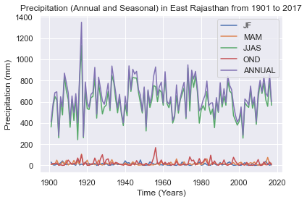
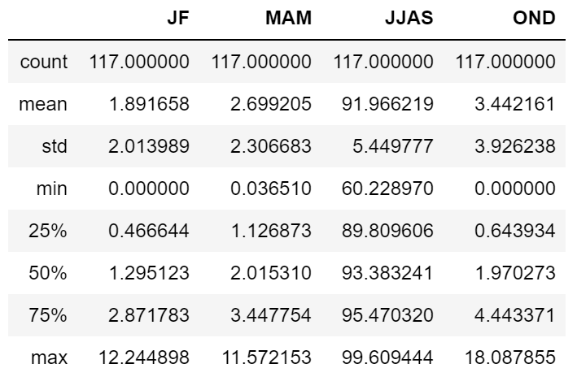
Proportion of Annual Rainfall per Season
Notes:
Another graph showing how each season contributes to the annual precipitation
Precipitation (annual and seasonal)
The purple line is the annual and the green line is JJAS (june, july, august, and september). This is monsoon season is during these summer months
The seasons are grouped by like months of precipitation
Looking at the means for each season, about 92% of the precipitation occurs in JJAS in monsoon season. Therefore, decided to have our model predict precipitation annually and assume 92% of that occured in the months of JJAS
Phase 1 of the project will predict the annual precipitation for the next several years and will be used in Phase 2 and Phase 3 to calculate the runoff and dam sizing, respectively.
From the annual precipitation, the seasonal precipitation will be estimated with the understanding that JJAS precipitation contributes about 91.966% to the annual precipitation.
Regarding, the extreme case of 99.609%, the dam size will be calculated with factors of safety.

Slide 19
Time Series

Slide 20
Time Series
DateTime Index for range of data
Average precip/ month (mm)
Avg temp/ month (℃)
Annual precip (mm)
Populated dataframes
Monthly and Annual sampling frequency
Matplotlib and Plotly
Notes:
We first cleaned up the data for our model - creating datetime indexes and dataframes for the average and annual precipitation and temperature in mm and degrees celsius respectively
We used monthly and annual sampling frequency, using matplotlib and ploty to help visual our data

Slide 21
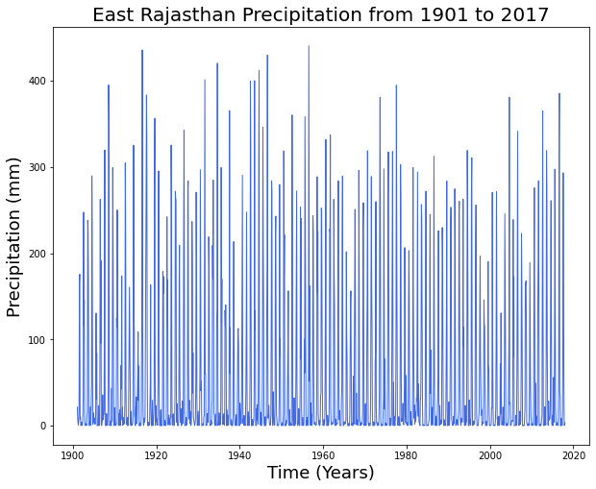
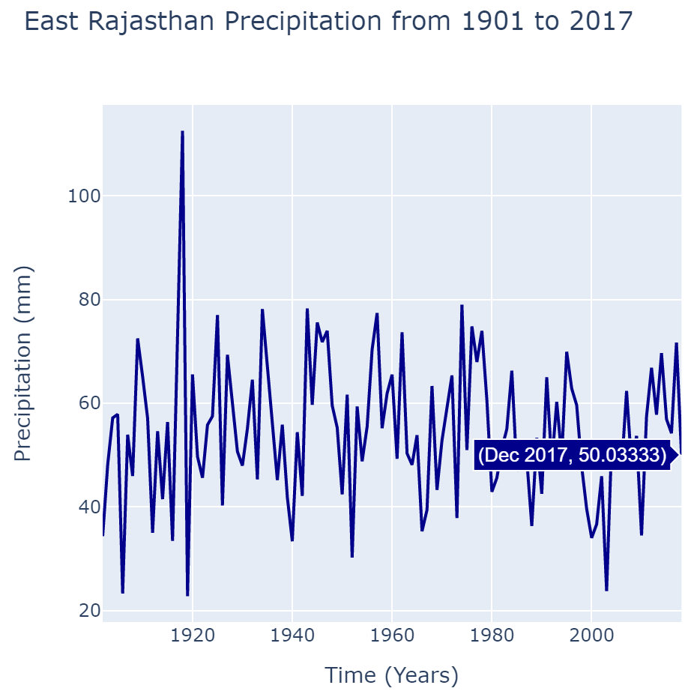
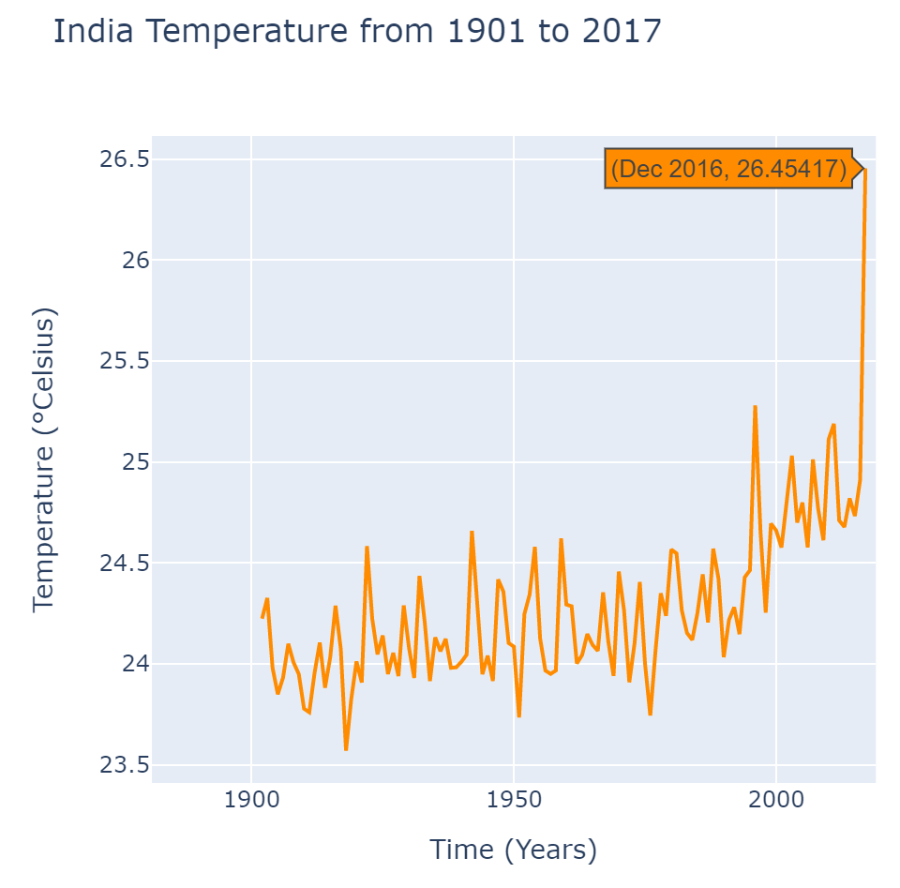
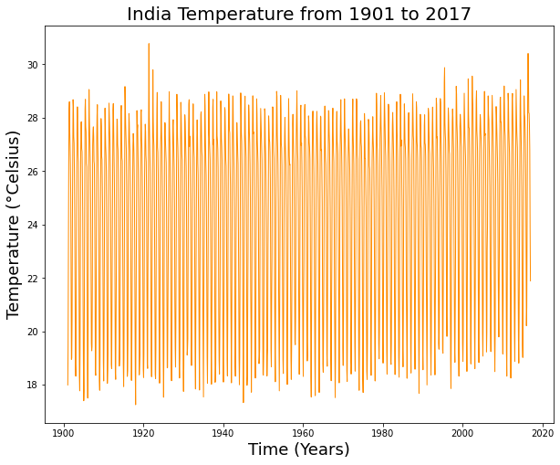
Precipitation & Temperature
Monthly Frequency
Resample - Annual Frequency
Notes:
Blue plots represent the precipitation and orange is the temperature
The plots on the left are the has a monthly frequency - looks quite messy, and the data covers such a long span of time (granular)
The visualization has a lot of variation
It seems that as time goes on, the peaks are decreasings
The plots on the right was plotted after resampling at a different frequency to try to remove such fluctuations
This plot is much clearer than the previous graph, the resampling makes it easier to determine and visualize the precipitation trends
Want to trace the annual trends with plotly graph
Useful to continue to observe the trends in precipitation and temperature
precipitation seems to be declining peaks compared while temperature has been increasing greatly

Slide 22
Time Series - Facebook Prophet
Forecasting precipitation using Facebook Prophet
Train model
Add temperature data and replot
Creating, fitting, and plotting precipitation model
Plot forecast
- Change points
- Forecast _components
Export forecast data to CSV
Notes:
Train the model with precipitation data
See the change points
Can examine the forecast components: we are interested in the trend (how precipitation is change from year to year) and the seasonality (how precipitation is changing throughout the year)
Add more data - temperature data and replot
Export forecast data to CSV and clean up data to be used in Phase 2

Slide 23
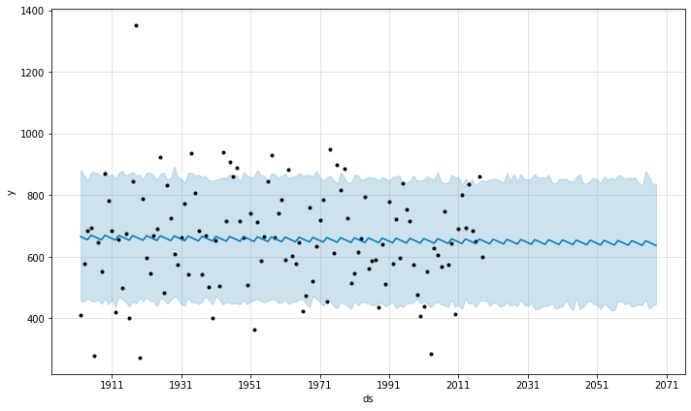
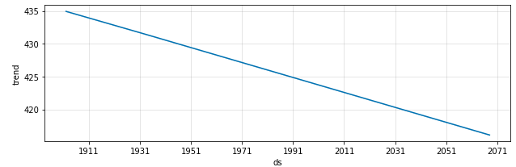
Facebook Prophet - Annual
Avg. Precipitation Forecast
Forecast Components
Precipitation (mm)
Time (Years)
Notes:
Also did different test and train sections including 50/50, 70/30, and 85/15

Slide 24
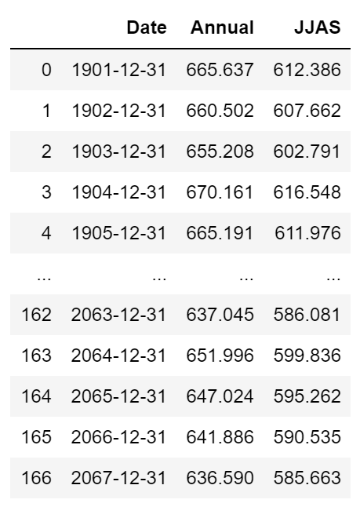
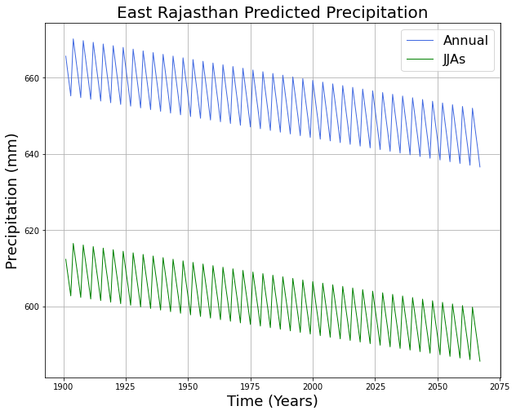
Precipitation Prediction
Output:
Precipitation Prediction: Annual and JJAS for next 50 years
Inputs:
Precipitation - East Rajasthan
Temperature - India
Notes:
Decreasing trend in the coming years
This is in alignment with information collected from locals
The green is the JJAS - these values will be used for the subsequent phases
The JJAS values were 92% of the annual values based on the preliminary data investigation I discussed earlier
This data is will be used
Future Work
Phases 1: More independent variables with time series analysis
Train and test model with other variables (1901-2002), compare to known precipitation (2003-2017)

Slide 25
05
Phase II
Rainfall - Runoff Conversion

Slide 26
Rainfall - Runoff Conversion Equation
Predicted Precipitation (mm) 2020-2070 for the Catchment Area
Conversion of Rainfall to Runoff
Catchment Yield of system (m³)
Yield (m³) = Annual Precipitation (mm) ✕ Area (hectares) ✕ Yield Coefficient ✕ 10⁻³ m³/L
Notes:
Compare equation used to the typical water balance equation and the simplifications and assumptions that had to be made.
Qs = P - ET - delta SM - delta GW
Surface Runoff = Precipitation - Evapotranspiration - Change in Soil Moisture - groundwater storage

Slide 27
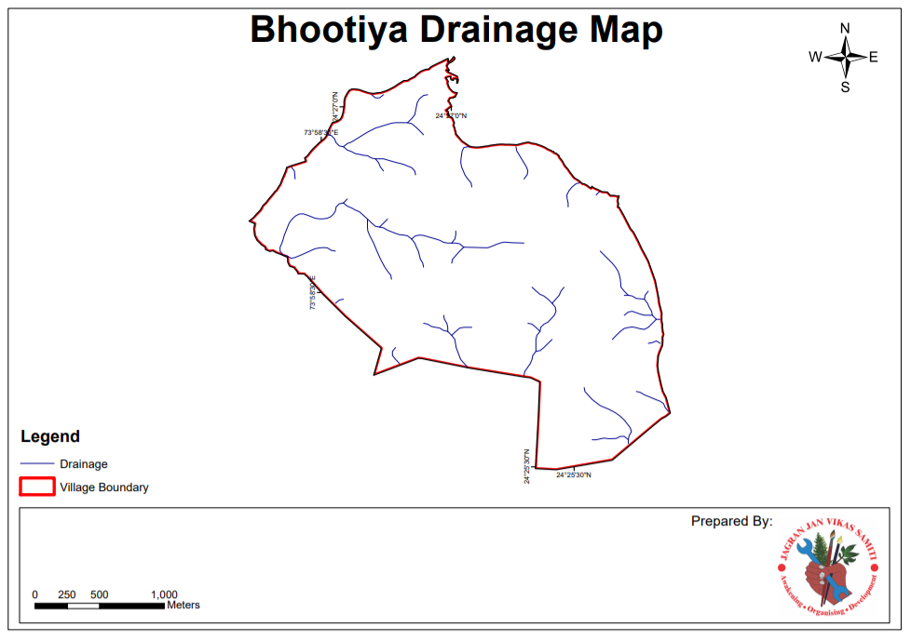
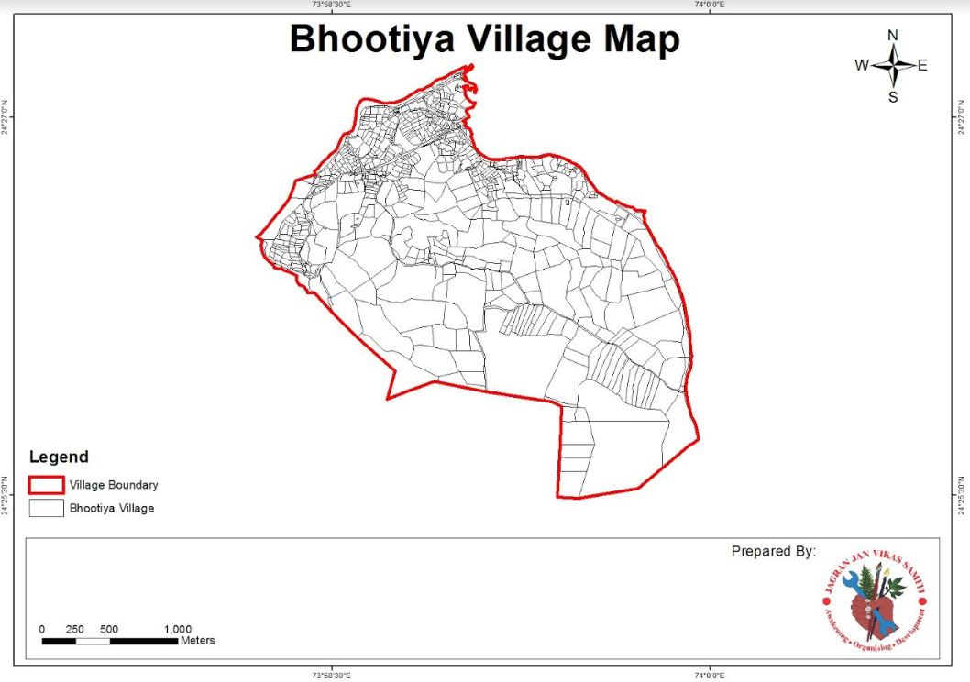
Catchment Area
Notes:
99.3249 hectares or about 1 million m^2
Equivalent to about ⅕ of village area

Slide 28
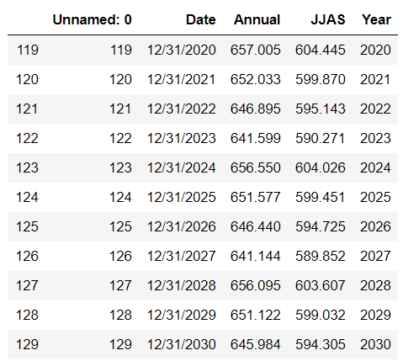
Annual Average Precipitation
Import CSV from Phase I
Predicted 2020-2067 (mm/yr)
92% of rainfall in Monsoon Season

Slide 29
Yield Coefficient
infiltration rate
evaporation rates
water storage capacities of soil
groundcover & vegetation
yc = 0.5
Notes:
Australian Ministry of Agriculture
Farm Water Calculator: Additional information. Determining Catchment Yield for Planning Farm Dams

Slide 30
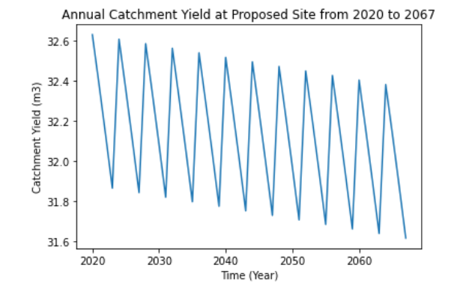
Output
Notes:
Mean 32.125575 Min 31.614619 Max 32.628478
25% 31.874068 50% 32.129594 75% 32.380178
Declining catchment yield trend… lessened resource availability is to be expected over the next 50 years as global temperatures rise (evaporation/transpiration increase), precipitation patterns change.

Slide 31



Improved Accuracy in Hydraulic Modeling
EWater Toolkit
SWAT / QSWAT
Bhuvan

Slide 32
06
Phase III
Sizing the Percolation Pond and the Dam

Slide 33
Dam Design

Slide 34
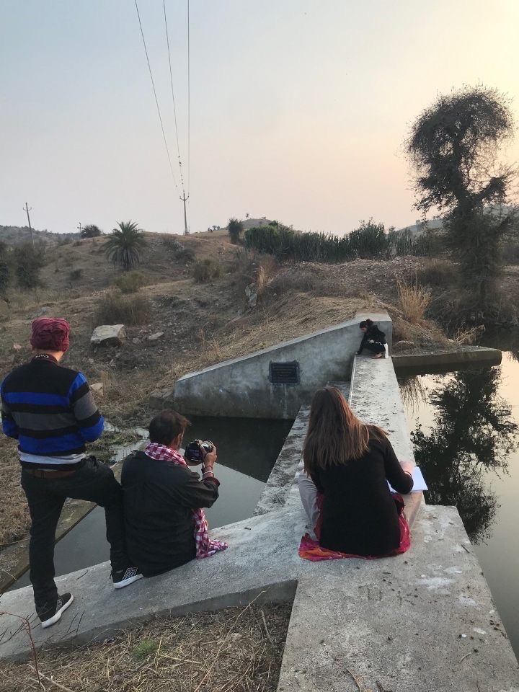
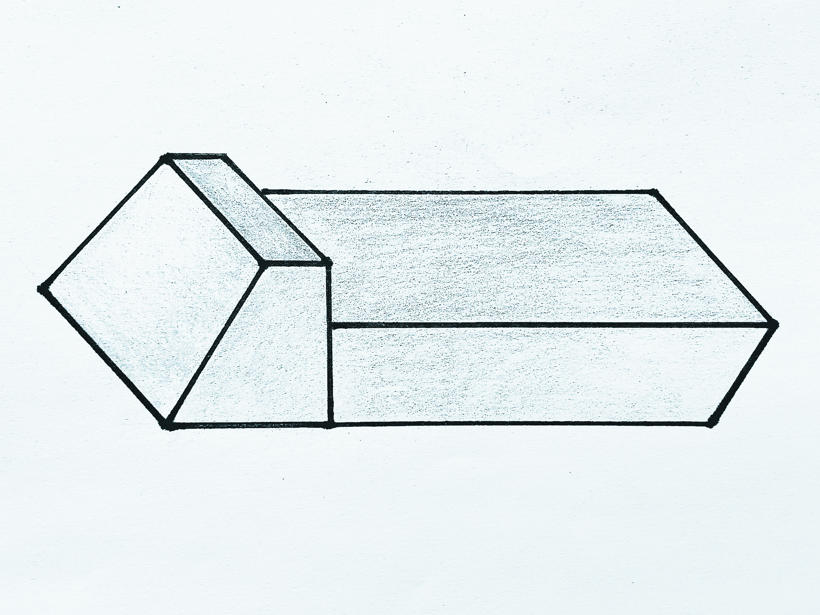
Anicut
Percolation Pond
Notes:
Neighboring village

Slide 35


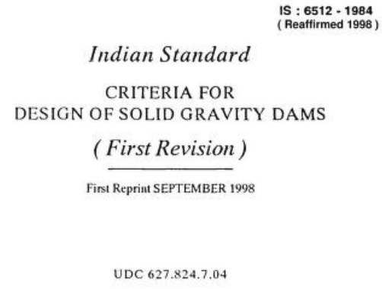
Background
Preliminary investigation into Small Dam Construction
Reference both Indian and U.S design standards
Looking for important dimensional relationships

Slide 36
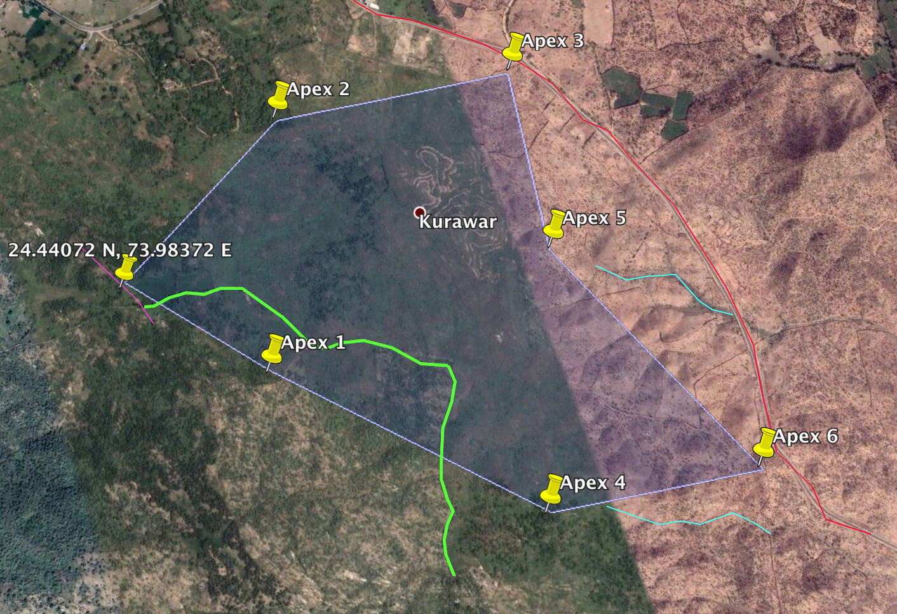
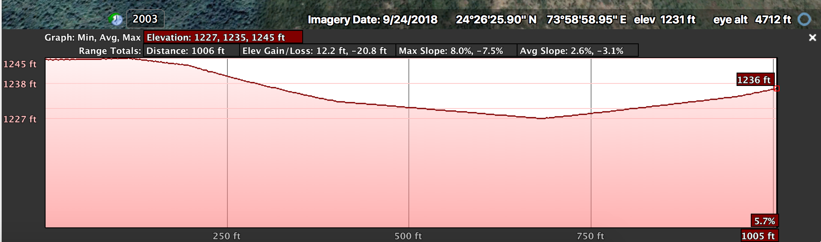
Data Collection
Google Earth Pro was utilized to collect data on the Elevation Profile of the proposed site of the Anicut Structure.

Slide 37
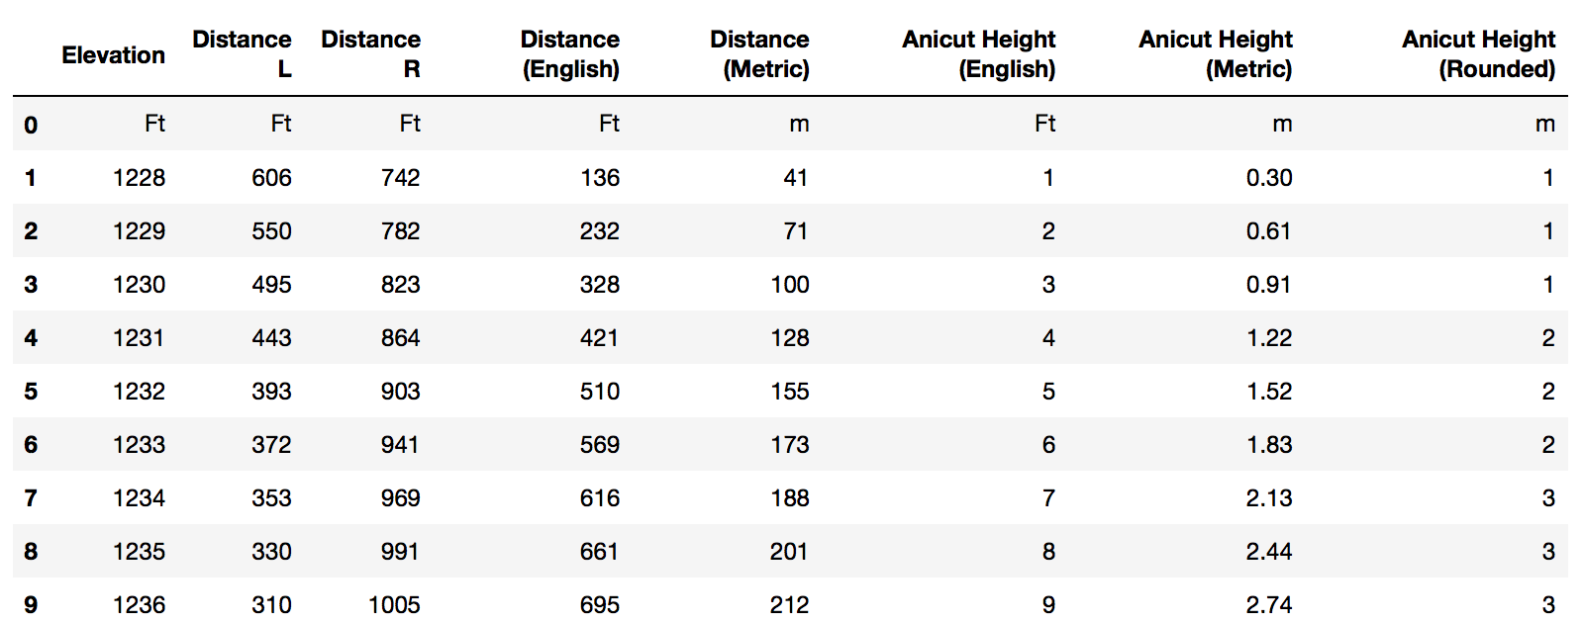
Data Collection
Valley Dimension

Slide 38
Assumptions
Anicut
Cross Section: Trapezoid
Reinforced Concrete Dam
Use of Normal Weight Concrete
Notes:
Did not have necessary data to include these effects on the yield capacity. Definitley something we are going to look on getting access in the future for further applications

Slide 39
Coding Dam Design
User Input determines Dam Design
Pond Dimensions + Valley shape establish geometric constraints
Emphasis on Constructable Feasibility and Simplicity
Crest
Freeboard Height
Downstream Slope
Total Height
Length

Slide 40
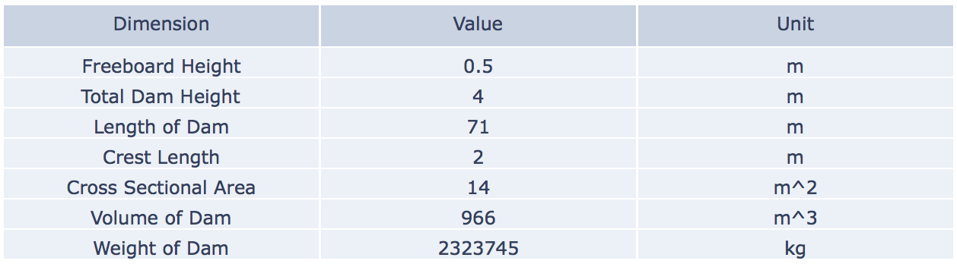
Outputs: Anicut Dam
(example)

Slide 41
Future Development
Anicut
Future Site Visit
Soil Research
Foundation Design
More accurate Elevation Profile
Incorporate Reinforcement Design into Concrete Structure

Slide 42
Percolation Pond Design

Slide 43

Background
USDA provided guidelines and methods commonly used in the design and construction of ponds.
United States Department of Agriculture Guide for Planning Ponds.
Notes:
Along with case studies in other areas in India, this gave guidance of shape, slope of pond walls, calculation of volume, other good suggestions

Slide 44
Assumptions
Pond
Shape: Trapezoidal Prism
GWT is below depth of excavation
No water lost to evapotranspiration in pond
No water added due to precipitation on pond
Notes:
Did not have necessary data to include these effects on the yield capacity. Definitely something we are going to look on getting access in the future for further applications

Slide 45
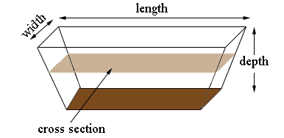
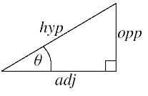
EQUATIONS REFERENCED
(⅙) (A + 4B + C) x D
Prismoidal Formula:
Tangent of a Triangle:
tan(theta) = opp./adj.
A
B
C
Notes:
Note the slope of each side of the shape

Slide 46
Inputs: Percolation Pond (example)
Ramp (1.5:1)
Others (0:1)
32.6 m^3
5 m
1 m
Slopes
Yield Capacity
(Phase II)
Top Width
Depth
Notes:
Found suggested slopes through literature reviews but are going to talk to experts on their opinions, that is why we decided to put this as a user input
Top width of the dam, must be less than the width of the dam
Suggested depth is 1 m based on simplifications of the volume
With this and formulas explained a minute ago, the necessary dimensions of the pond were found through substitution and systems of equations.

Slide 47
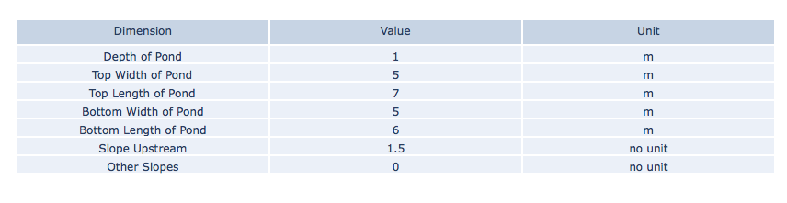
Outputs: Percolation Pond (example)

Slide 48
Future Development
Percolation Pond
Pond Slopes
Geotechnical Analysis
Excavation Material
Contour Trenching to capture more water
Notes:
Physical Limitations

Slide 49
Further Applications
&
Closing Remarks

Slide 50
THANK YOU
Questions?

Slide 51
References
Ali, Syed Ahmad, et al. "Watershed analysis and Landuse Management to Protect from Flash Flood in the Semi-Arid Region Udaipur, Northwestern India using Geospatial Techniques." ReserachGate, Feb. 2018, www.researchgate.net/publication/322950783_Watershed_analysis_and_Landuse_Management_to_Protect_from_Flash_Flood_in_the_Semi-Arid_Region_Udaipur_Northwestern_India_using_Geospatial_Techniques. Accessed 19 Apr. 2020.
Boggs, H L. “Chapter 8: Concrete Gravity Dams .” Design of Small Dams, edited by C C Hennig, 3rd ed., United States Department of the Interior Bureau of Reclamation, 1987, pp. 315–336.
Bureau of Indian Standards. "Hydraulic Design of Barrages and Weirs - Guidelines." Public.Resource.Org, Dec. 1989, law.resource.org/pub/in/bis/S14/is.6966.1.1989.pdf. Accessed 19 Apr. 2020.
Bureau of Reclamation. "Design of Small Dams." United States Department of the Interior, 3rd ed. Bureau of Reclamation, 1987, www.usbr.gov/tsc/techreferences/mands/mands-pdfs/SmallDams.pdf. Accessed 19 Apr. 2020.
"Dams and Reservoir Design." Alberta WaterPortal Society, albertawater.com/lifecycle-of-a-dam-and-reservoir/dam-and-reservoir-design. Accessed 19 Apr. 2020.
Dinar, Ariel, et al. Measuring the impact of climate change on Indian agriculture. The World Bank, documents.worldbank.org/curated/en/793381468756570727/Measuring-the-impact-of-climate-change-on-Indian-agriculture. Accessed 19 Apr. 2020.
Farm Water Calculator: Determining Catchment Yield for Planning Farm Dams. (n.d.). Retrieved April 5, 2020, from http://calculator.agriculture.vic.gov.au/fwcalc/information/determining-catchment-yield-for-planning-farm-dams
Hausfather, Zeke. "What climate models tell us about future rainfall." Carbon Brief, 19 Jan. 2018, www.carbonbrief.org/explainer-what-climate-models-tell-us-about-future-rainfall. Accessed 19 Apr. 2020.
Manak, Bhavan, and Bahadur Shah Zafar Marg. HYDRAULIC DESIGN OF BARRAGES AND WEIRS - GUIDELINES. Bureau of Indian Standards , 1989, law.resource.org/pub/in/bis/S14/is.6966.1.1989.pdf.

Slide 52
References
Indian Meteorological Department. "District-wise monthly rainfall data, list of raingauge stations, India Meteorological Department (IMD)." India Water Portal, 1 Sept. 2012, www.indiawaterportal.org/articles/district-wise-monthly-rainfall-data-list-raingauge-stations-india-meteorological-department. Accessed 19 Apr. 2020.
---. "Met Data." Indian Water Portal, www.indiawaterportal.org/met_data/. Accessed 19 Apr. 2020.
Jasrotia, A. S., Majhi, A., & Singh, S. (2009). Water balance approach for rainwater harvesting using remote sensing and GIS techniques, Jammu Himalaya, India. Water resources management, 23(14), 3035-3055. Retrieved April 5, 2020.
Koehrsen, Will. "Time Series Analysis in Python: An Introduction." Towards Data Science, 12 Jan. 2018, towardsdatascience.com/time-series-analysis-in-python-an-introduction-70d5a5b1d52a. Accessed 19 Apr. 2020.
Legates, David R. "Climate Models and Their Simulation of Precipitation." Energy & Environment, vol. 25, no. 6/7, pp. 1163-75. JSTOR, www.jstor.org/stable/pdf/43735310.pdf?refreqid=excelsior%3Acf81acbeb07afa70d8ce4fe606dceca6. Accessed 19 Apr. 2020.
McQuistan, Adam. "Using Machine Learning to Predict the Weather." StackAbuse, stackabuse.com/using-machine-learning-to-predict-the-weather-part-1/. Accessed 19 Apr. 2020.
Mohanty, Bibhabasu. "Reservoir - Module III." SlideShare, 12 June 2012, www.slideshare.net/bibhabasumohanty/reservoir-13443272. Accessed 19 Apr. 2020.
Penny. MathCentral. Photo Retrieved from http://mathcentral.uregina.ca/QQ/database/QQ.09.11/h/jan1.html
Rajasthan, Water Portal. Study on Planning of Water Resources of Rajasthan. Oct. 2014, water.rajasthan.gov.in/content/dam/water/water-resources-department/Knowledge%20Centre,downloads/Reports/TahalReportexecutivesummary/Exec%20Summary.pdf.#riverbasinstudyreport. Accessed 19 Apr. 2020.
Sanghi, Apurva, et al. "India Agriculture and Climate Data Set." The Bureau for Research and Economic Analysis of Development, ipl.econ.duke.edu/dthomas/dev_data/datafiles/india_agric_climate.htm. Accessed 19 Apr. 2020.
World Water & Climate Atlas. www.iwmi.cgiar.org/resources/world-water-and-climate-atlas/. Accessed 19 Apr. 2020.
United States Department of Agriculture (November 1997). Ponds- Planning, Design, and Construction. Retrieved from http://agrilife.org/water/files/2013/02/ponds-planning-design-and-construction.pdf.

